Slide 1
Chapter 13: Forces in Fluids

Slide 2
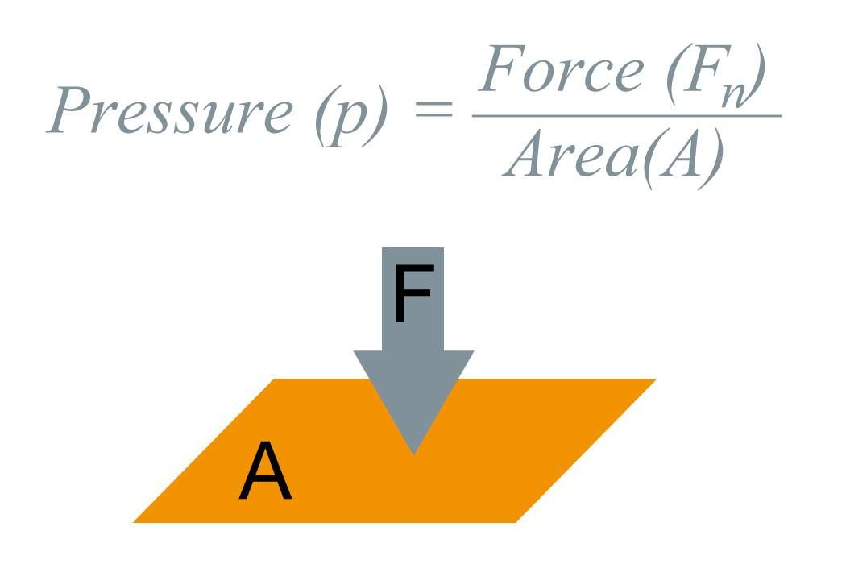
Pressure=
Force
_____
Area

Slide 3
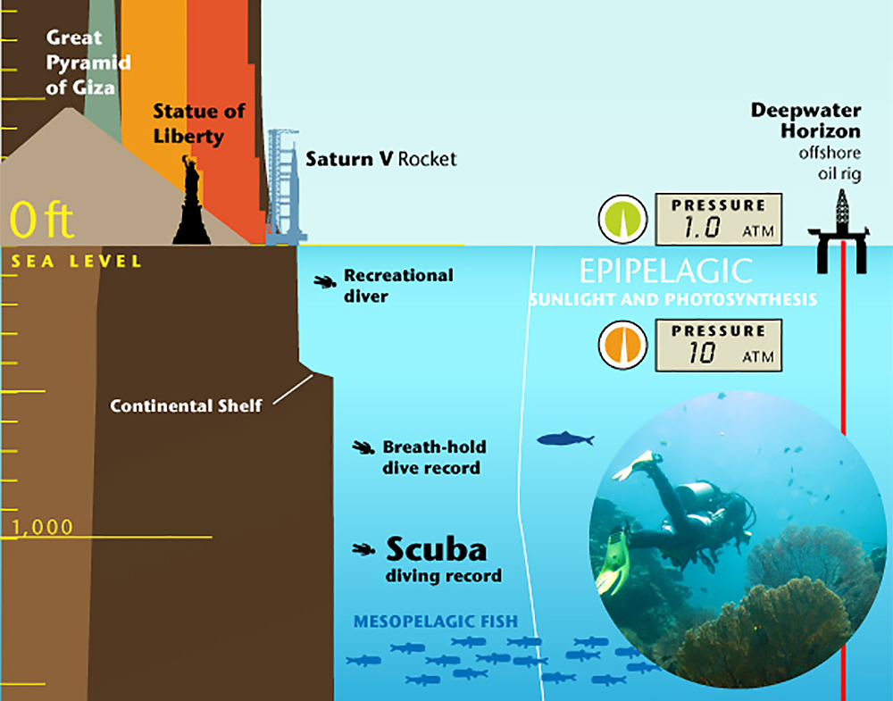
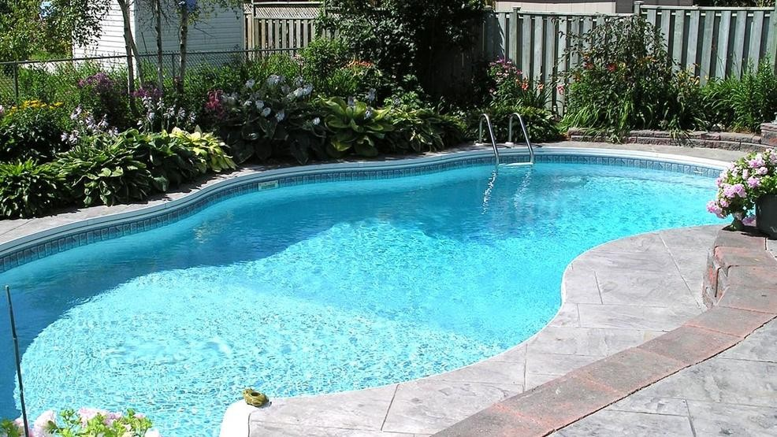
Water Pressure

Slide 4
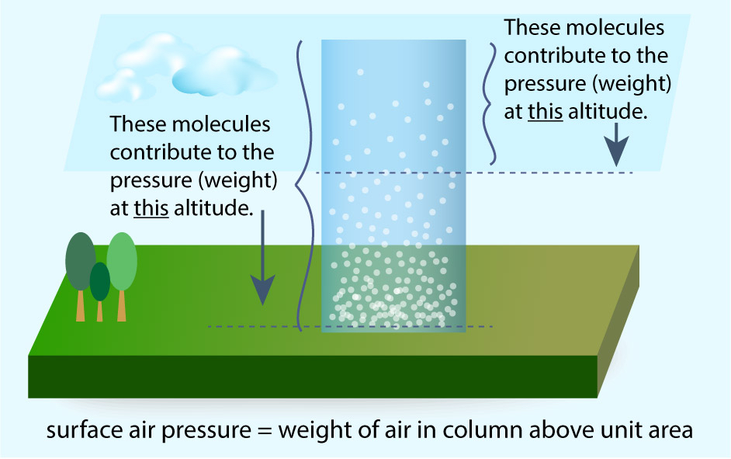
Air Pressure

Slide 5
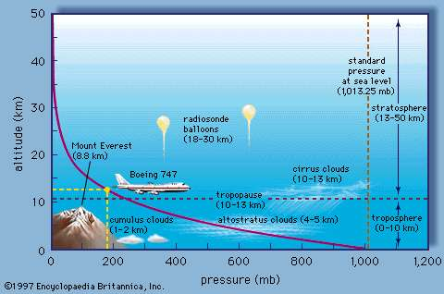
Air Pressure

Slide 6
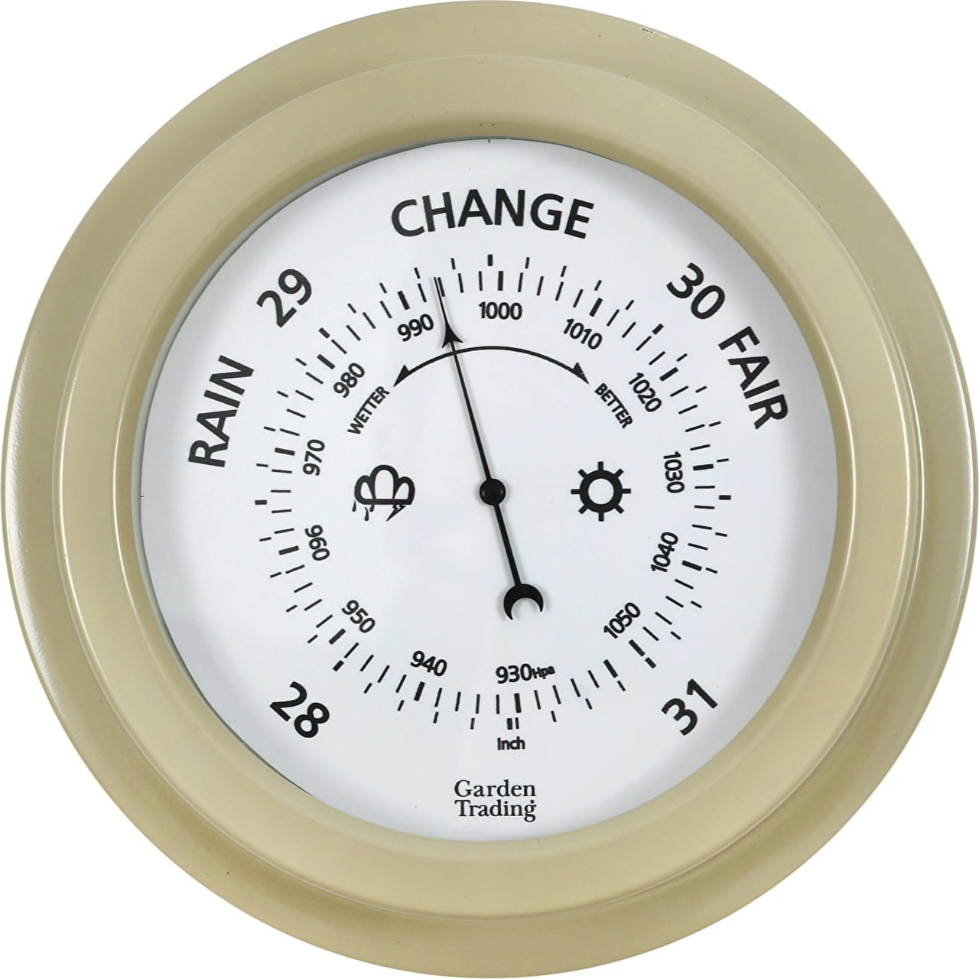
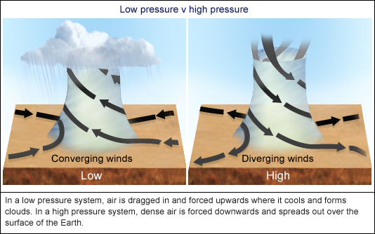
Air Pressure and Weather

Slide 7
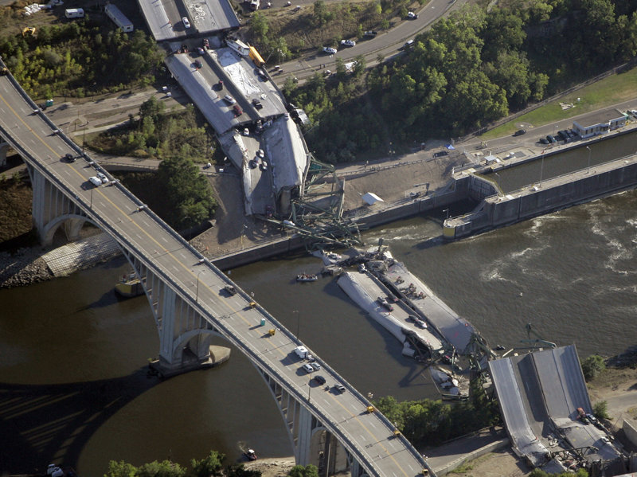
Structural Pressure

Slide 8
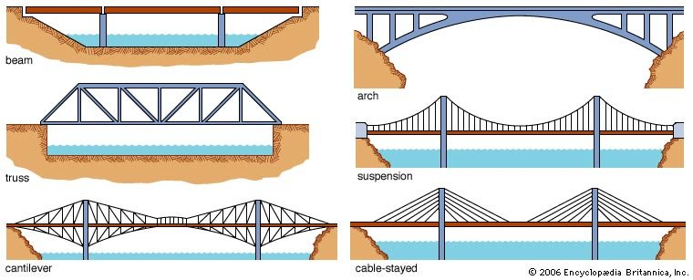
Structural Pressure

Slide 9
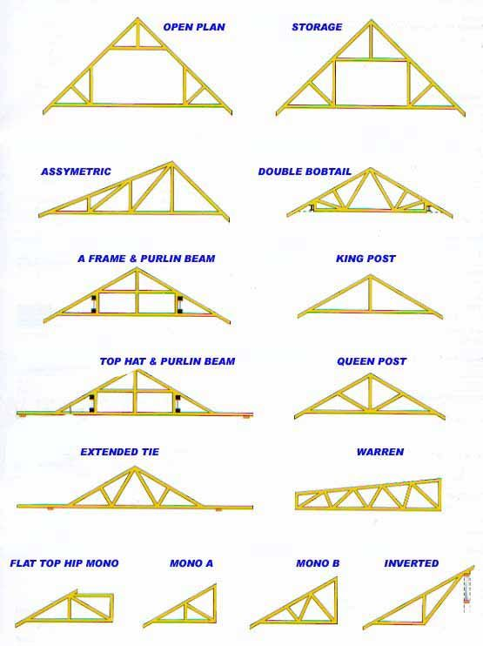
Structural Pressure

Slide 10
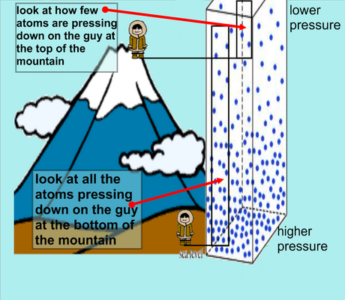
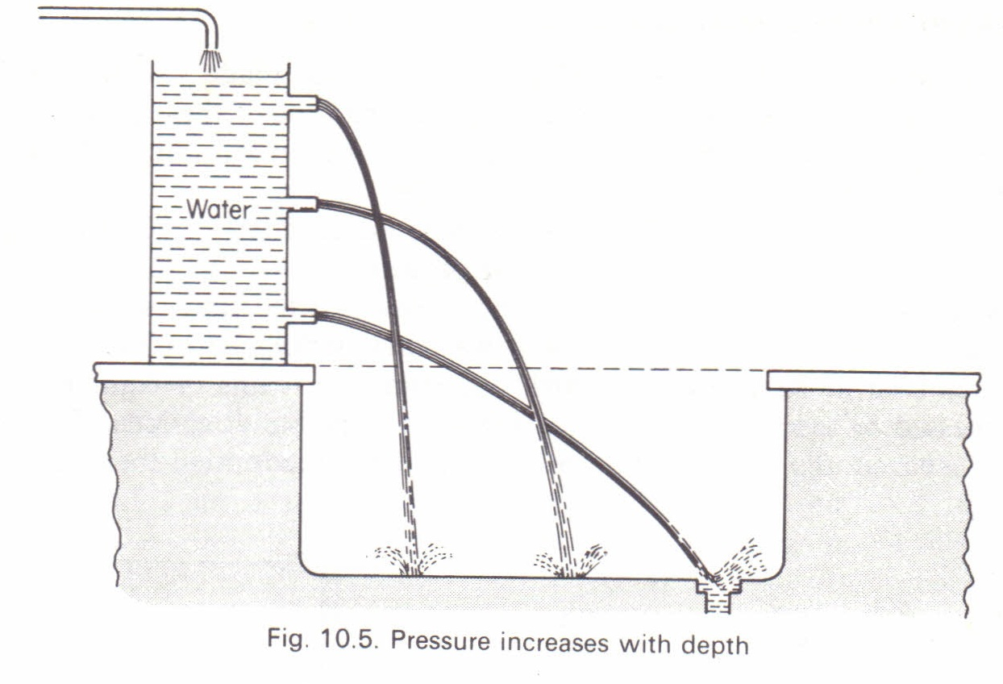
Pressure in Fluids
Fluid-a substance that assumes the shape of its container

Slide 11
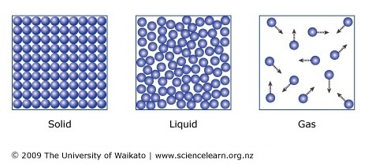
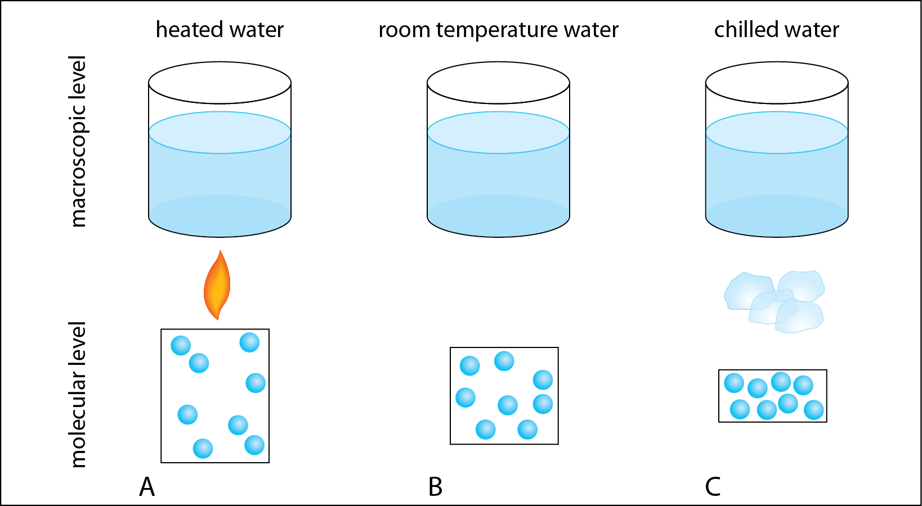
Pressure in Fluids

Slide 12
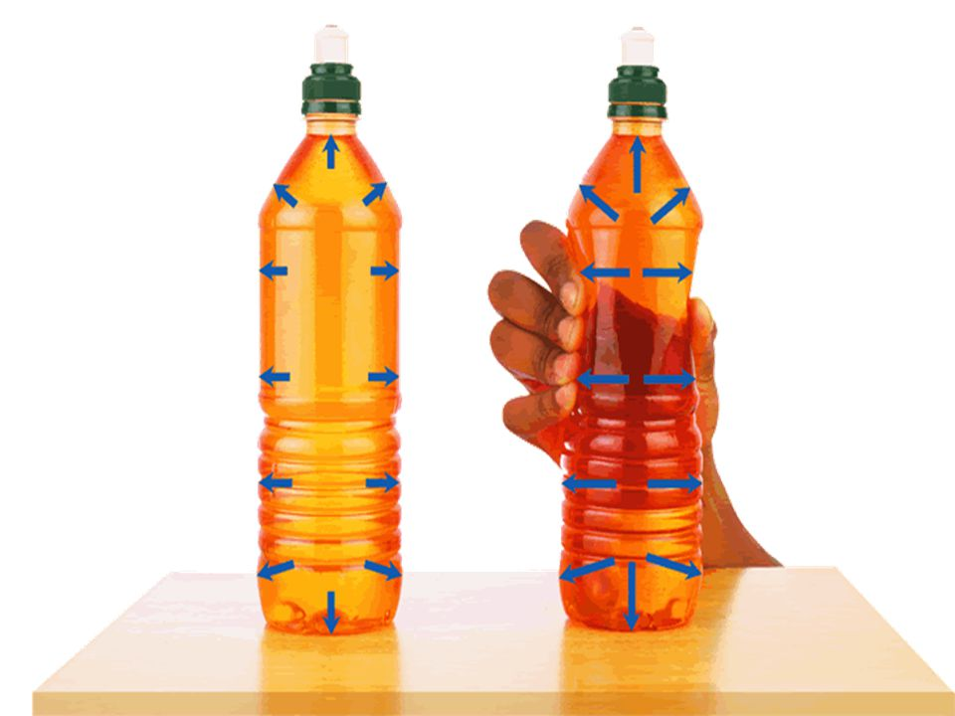
Pascal’s Principle
A change in pressure at any point in a fluid is transmitted equally and unchanged throughout the fluid

Slide 13
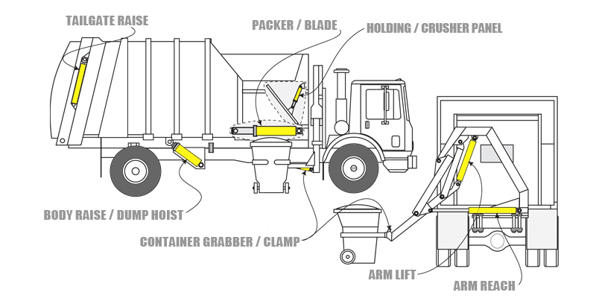
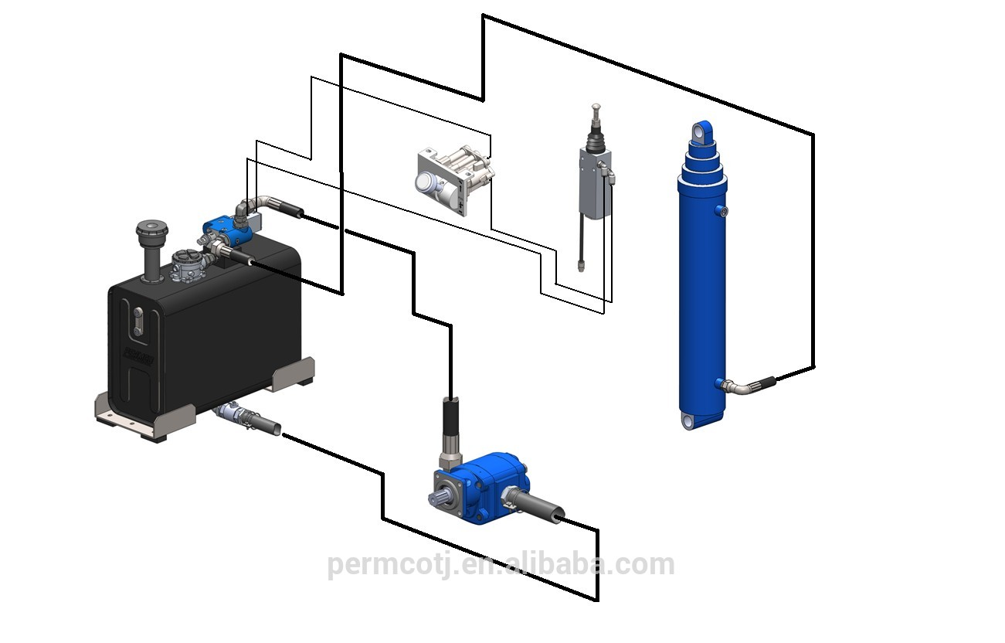
Hydraulic System
A way to use pressurized fluid, usually air, to change force.

Slide 14
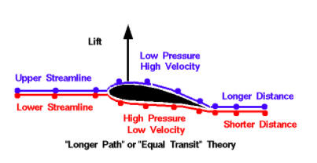
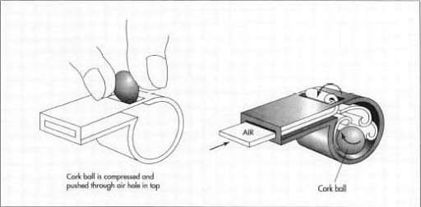
Bernoulli’s Principle
As the speed of the fluid increases, the pressure within the fluid decreases.

Slide 15
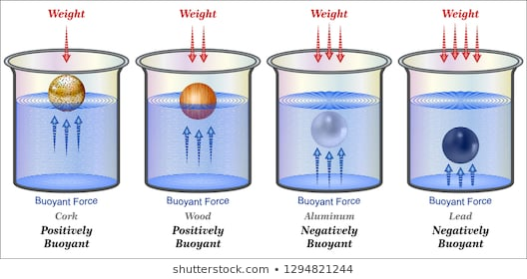
Buoyancy
Ability of a fluid to exert an upwards force on an object.

Slide 16
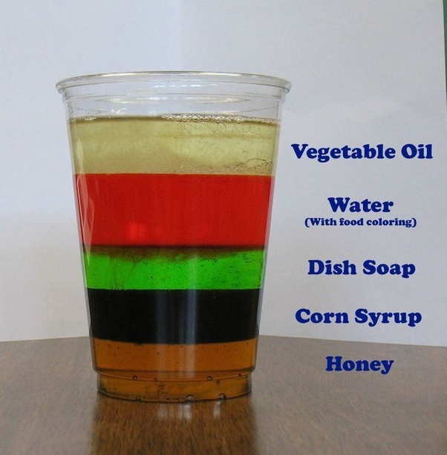
Buoyancy
Density= mass divided by volume

Slide 17
Density-Revisited
Density= mass divided by volume

